Slide 1
Controlling Dual Axis Solar Panels with Arduino
Presented by :
N.Sireesha
V.Murali
Ch.Vamsi
S.Basherbegam
M.jhansi
M.Davidraju

Slide 2
Introduction
What are Dual Axis Solar Panels?
Why Use Arduino for Dual Axis Solar Panel Control?
How to Build a Dual Axis Solar Panel Controller using Arduino
Benefits of Solar Panel Control
Conclusion

Slide 3

Introduction
Welcome to the world of renewable energy! As we all know, solar power is one of the cleanest sources of energy available today. However, traditional solar panels have their limitations when it comes to efficiency. This is where dual axis solar panels come in. In this presentation, we will explore how to control dual axis solar panels using Arduino and why it is important.
The concept of dual axis solar panels may seem like something out of a sci-fi movie, but it is very real. These panels are designed to track the sun's movement in two directions, which allows them to capture more sunlight throughout the day. By controlling these panels using Arduino, we can optimize their performance even further. So, let's dive into the world of dual axis solar panel control using Arduino!

Slide 4

What are Dual Axis Solar Panels?
Dual axis solar panels are a type of solar panel that can track the sun's movement in two directions: up-and-down and side-to-side. This means that they can capture more sunlight throughout the day, which makes them more efficient than traditional solar panels.
Unlike traditional solar panels, which are fixed in place, dual axis solar panels use motors and sensors to adjust their position based on the sun's location. This allows them to maintain an optimal angle towards the sun at all times, maximizing their energy output. Dual axis solar panels are particularly useful in areas with high latitudes or variable weather patterns, where the sun's position in the sky changes frequently.

Slide 5

Why Use Arduino for Dual Axis Solar Panel Control?
Arduino is an ideal platform for controlling dual axis solar panels due to its flexibility, affordability, and ease of use.
With Arduino, you can easily program the controller to adjust the position of the solar panels based on the angle of the sun, ensuring maximum efficiency and energy production. Additionally, the open-source nature of Arduino allows for easy customization and integration with other systems.

Slide 6
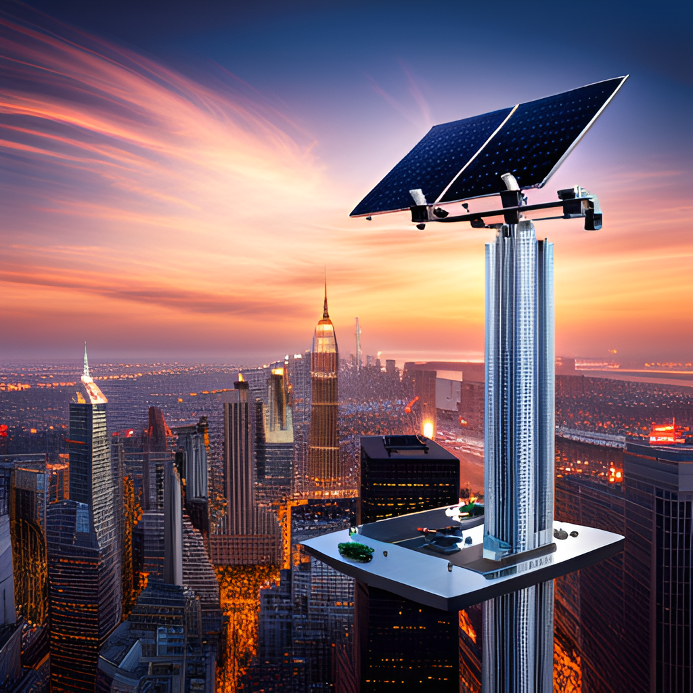
How to Build a Dual Axis Solar Panel Controller using Arduino
To build a dual axis solar panel controller using Arduino, you will need the following components: an Arduino Uno board, a motor shield, two servo motors, a light sensor, and a breadboard.
First, connect the motor shield to the Arduino Uno board and attach the two servo motors to the shield. Then, connect the light sensor to the breadboard and attach it to the Arduino board. Next, write the code for the Arduino board to control the servo motors based on the input from the light sensor. Finally, test the system by exposing the light sensor to different light levels and observing how the servo motors respond.

Slide 7
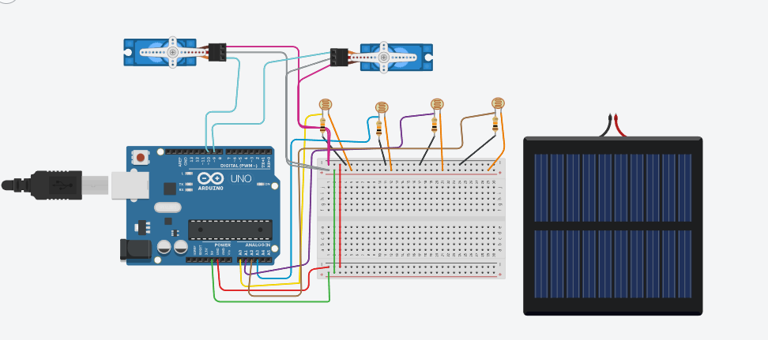

Slide 8
// Pins for servo motors
const int tiltServoPin = 9; // Connect tilt servo to pin 9
const int azimuthServoPin = 10; // Connect azimuth servo to pin 10
// Pins for light sensors
const int tiltSensorPin = A0; // Connect tilt sensor to analog pin A0
const int azimuthSensorPin = A1; // Connect azimuth sensor to analog pin A1
// Calibration values for sensors
const int tiltSensorMinValue = 0; // Minimum sensor value for tilt
const int tiltSensorMaxValue = 1023; // Maximum sensor value for tilt
const int azimuthSensorMinValue = 0; // Minimum sensor value for azimuth
const int azimuthSensorMaxValue = 1023; // Maximum sensor value for azimuth
// Servo objects
Servo tiltServo;
Servo azimuthServo;
void setup() {
// Attach servo objects to the respective pins
tiltServo.attach(tiltServoPin);
azimuthServo.attach(azimuthServoPin);
// Calibrate servo angles if required
tiltServo.write(90); // Set initial tilt angle
azimuthServo.write(90); // Set initial azimuth angle
// Set the sensor pin modes
pinMode(tiltSensorPin, INPUT);
pinMode(azimuthSensorPin, INPUT);
}
void loop() {
// Read sensor values
int tiltSensorValue = analogRead(tiltSensorPin);
int azimuthSensorValue = analogRead(azimuthSensorPin);
// Map sensor values to servo angles
int tiltAngle = map(tiltSensorValue, tiltSensorMinValue, tiltSensorMaxValue, 0, 180);
int azimuthAngle = map(azimuthSensorValue, azimuthSensorMinValue, azimuthSensorMaxValue, 0, 180);
// Update servo positions
tiltServo.write(tiltAngle);
azimuthServo.write(azimuthAngle);
delay(100); // Adjust this delay as per your requirements
}

Slide 9

Benefits of Solar Panel Control
One major benefit of using a dual axis solar panel controller with Arduino is increased efficiency. By continuously tracking the sun's movement, the panels can be adjusted to receive maximum sunlight throughout the day. This results in more energy production and ultimately saves money on electricity bills.
Another benefit is improved durability. With Arduino, the controller can be programmed to respond to weather conditions such as high winds or heavy rain. This ensures that the panels are protected from damage and can last longer.

Slide 10

Conclusion
In conclusion, we have learned about the benefits of using dual axis solar panels and how they differ from traditional solar panels. We have also discussed why Arduino is a great choice for controlling dual axis solar panels and provided a step-by-step guide on how to build a dual axis solar panel controller using Arduino.
By using a dual axis solar panel controller with Arduino, we can optimize the amount of energy our solar panels generate and ensure they are always facing the sun. This not only saves us money but also helps reduce our carbon footprint and contribute to a more sustainable future.

